Slide 1

Session 3 Notes
Networking Protocols
Deep Dive
Understanding DNS, TCP, and UDP - The Foundation of Internet Communication
DNS Architecture
TCP Protocol
UDP Protocol

Slide 2
Overview
Contents
01
Domain Name System
02
TCP Protocol
The Internet's phonebook translating domain names to IP addresses through hierarchical resolution
Reliable, connection-oriented protocol ensuring ordered data delivery with error handling
DNS Resolution
Caching
3-Way Handshake
Retransmission
03
UDP Protocol
04
Protocol Comparison
Fast, connectionless protocol for real-time applications without delivery guarantees
Side-by-side analysis of TCP vs UDP characteristics, use cases, and performance trade-offs
Low Latency
Streaming
Trade-offs
Use Cases

Slide 3
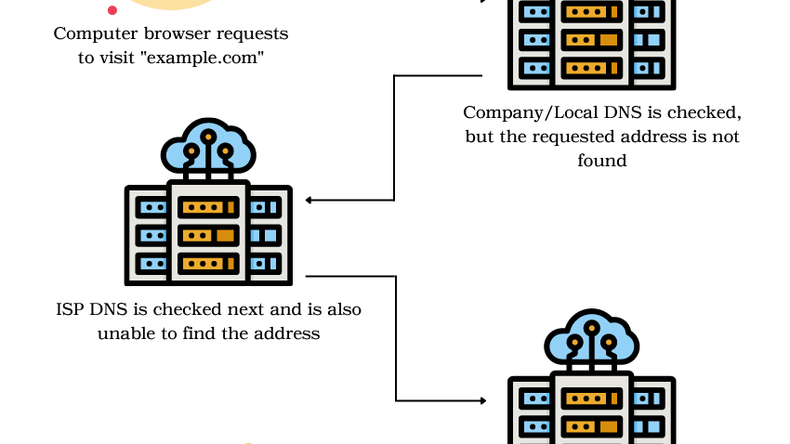
Chapter 01
Domain Name
System
The Internet's Phonebook - How Domain Names Map to IP Addresses
Hierarchical Resolution
Global Distribution

Slide 4
DNS Fundamentals
What is DNS?
Definition
The Library Analogy
DNS = Domain Name System — the phonebook of the internet. It translates human-readable domain names (like www.codersgyan.com) into machine-readable IP addresses (like 104.21.16.1).
You (User)
Want to find a book
Management
Managed by ICANN (Internet Corporation for Assigned Names and Numbers), a non-profit organization responsible for coordinating the global internet's systems of unique identifiers.
Librarian (DNS)
Helps locate the book
Index System
Why Domain Names?
Maps titles to locations
Humans are better at remembering names than numbers. Remembering "google.com" is infinitely easier than memorizing "142.250.80.46".
Book (Website)
Final destination found

Slide 5
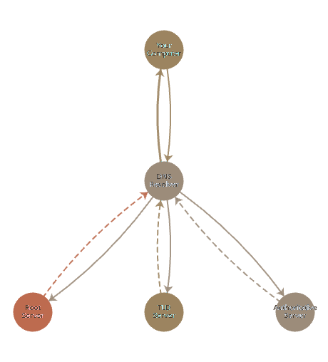
DNS Workflow
DNS Resolution Process
Step-by-step journey from domain name to IP address
1
Checking Local Cache
DNS Resolution Flow
Before making external requests, your system checks local storage for previously resolved domains.
Browser Cache
OS-Level Cache
2
DNS Resolver / Recursor
If local cache misses, request goes to a DNS Resolver — like a librarian who helps find the right section.
ISP Default
Google 8.8.8.8
Cloudflare 1.1.1.1
3
Root Nameservers
The resolver asks Root Nameserver — acts like an index in a library. It directs to the correct TLD server based on domain extension (e.g., .com).
4
TLD Nameserver
The .com TLD nameserver acts like a section dedicated to .com domains. It knows where to find codersgyan.com and directs to the Authoritative Nameserver.
5
Authoritative Nameserver
Holds the final answer — provides the exact IP address (e.g., 104.21.16.1). The resolver sends it back to your browser to load the website.

Slide 6
Performance Optimization
DNS Caching & Propagation
Why Updates Take Time?
Caching Benefits
DNS changes take time to propagate globally because Root, TLD, and Authoritative Nameservers worldwide need to update their records.
Faster Loading
Websites load faster by avoiding repeated DNS lookups for frequently visited sites
TTL (Time-to-Live): Determines how long DNS records are cached before refreshing. Lower TTL = faster updates but more queries.
Reduced Traffic
Lessens the overall burden on DNS infrastructure and network bandwidth
Three Levels of Caching
Improved Reliability
Browser Cache
Local caching provides fallback if DNS servers are temporarily unavailable
Stores previously visited domain records to avoid repeated lookups
OS-Level Cache (DNS Client)
Operating system maintains a temporary DNS cache for all applications
DNS Resolver Cache
ISPs and providers (Google 8.8.8.8, Cloudflare 1.1.1.1) maintain large caches
Why Not Direct ICANN Communication?
Our request doesn't go directly to ICANN. Instead, it interacts with DNS Resolvers , which handle communication with Root, TLD, and Authoritative Nameservers. This distributed system makes the process efficient and scalable.

Slide 7
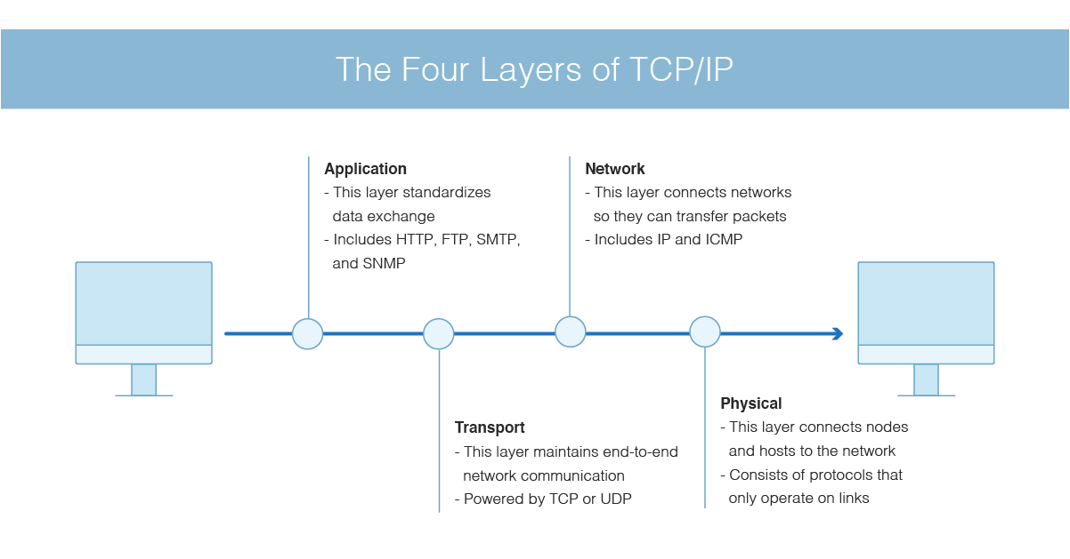
Chapter 02
TCP
Protocol
Transmission Control Protocol - Reliable, Connection-Oriented Communication
Guaranteed Delivery
Ordered Data

Slide 8
TCP Overview
TCP Fundamentals
What is TCP?
Why Use TCP?
TCP (Transmission Control Protocol) is one of the main protocols of the TCP/IP suite, lying between the Application and Network Layers.
Reliability
Connection-oriented protocol
Acknowledgment and retransmission mechanism ensures lost or corrupted segments are resent. Critical for file transfers, emails.
Breaks data into segments
Reassembles at destination
Ordered Data Delivery
Multiple route capability
Guarantees data is received in the same sequence it was sent, preventing misordered data issues.
TCP/IP Protocol Stack
Congestion & Flow Control
Application Layer
Adjusts transmission rate based on network conditions and receiver capacity to optimize throughput.
HTTP, SMTP, FTP
Transport Layer ← TCP
Universality & Error Detection
Reliable data transfer
Used by HTTP, SMTP, FTP. Every segment has a checksum for error detection and correction.
Network Layer
IP, routing
Physical Layer
Hardware, cables

Slide 9
Packet Structure
TCP Headers Structure
Every TCP segment contains a header (20-60 bytes) with control information
TCP Header Format
Key Header Fields
Source Port
16 bits
01
Source Port
Identifies the sending application (e.g., port 80 for HTTP)
Port number of the sending application
Destination Port
02
Destination Port
16 bits
Identifies the receiving application on the target host
Port number of the receiving application
03
Sequence Number
Tracks byte position for ordered reassembly
Sequence Number
32 bits
04
Acknowledgment Number
Byte position of the first data byte in current segment
Confirms receipt and indicates next expected byte
05
Checksum
Acknowledgment Number
32 bits
Error detection value to ensure data integrity
Sequence number of next byte expected by receiver
Data Offset + Reserved + Flags
16 bits
Header Size
Header length, reserved bits, control flags (SYN, ACK, FIN, etc.)
Varies from 20 bytes (minimum) to 60 bytes (with options)
Window Size + Checksum + Urgent
48 bits
Flow control window, error detection checksum, urgent pointer
Options + Padding
Variable
Optional fields for additional functionality
DATA
Variable

Slide 10
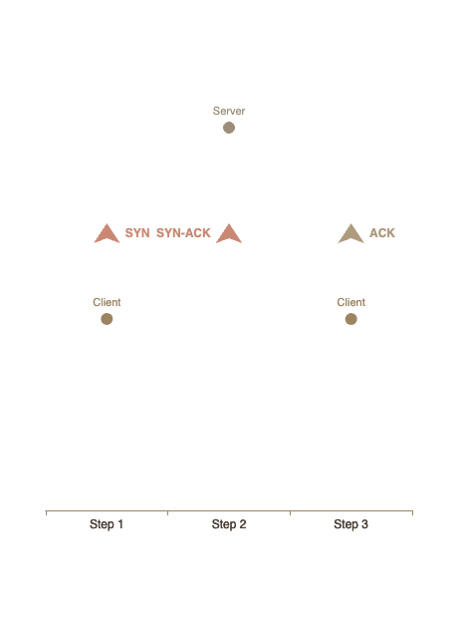
Connection Establishment
TCP 3-Way Handshake
The process to establish a reliable connection before data transfer
1
Client Sends SYN
Handshake Visualization
The client wants to start a TCP connection and sends a SYN (Synchronize) packet to the server.
Sender
Seq No
Ack No
Flags
Client → Server
1000
0
SYN
ISN (Initial Sequence Number) = 1000, randomly chosen for security
2
Server Sends SYN-ACK
The server receives SYN and responds with SYN-ACK (Synchronize + Acknowledgment).
Sender
Seq No
Ack No
Flags
Server → Client
5000
1001
SYN-ACK
Server ISN = 5000, Ack = Client ISN + 1 (1001)
3
Client Sends ACK
The client receives SYN-ACK and sends ACK back to confirm. Connection established!
Sender
Seq No
Ack No
Flags
Client → Server
1001
5001
ACK
Ack = Server ISN + 1 (5001), confirming receipt

Slide 11
Data Transmission
TCP Data Transfer & Retransmission
Practical Example: Transferring 3MB Image
TCP Retransmission
Step 1: 3-Way Handshake
When Does Retransmission Occur?
Connection must be established before any data transfer
Packet is lost in transit
Checksum fails at receiver
Step 2: Creating Segments
No acknowledgment (ACK) received
File Size: 3,145,728 bytes
MSS (Maximum Segment Size): 1,460 bytes/segment
Total Segments: 3,145,728 ÷ 1,460 ≈ 2,155 segments
Retransmission Timeout (RTO)
Timeout before retrying:
Linux:
~200ms to 3s
Data Transfer Process
Windows:
~300ms to 3s
RFC 6298:
1s default
Send First Segment
Sender
Seq No
Ack No
Payload
Client → Server
1001
5001
1,460B
Exponential Backoff
✓ Server acknowledges: Ack = 2461 (1001 + 1460) = Sender Seq No. + MSS(Payload) = Seq No. of 2nd or. Next Segment
After each failed retry, timeout doubles:
1s
2s
4s
8s
...
Send Second Segment
Sender
Seq No
Ack No
Payload
Linux
Windows
MacOS
15 retries
5 retries
~15 retries
Client → Server
2461
5001
1,460B
✓ Server acknowledges: Ack = 3921 (2461 + 1460)
Process repeats until all 3MB is transferred...

Slide 12

Chapter 03
UDP
Protocol
User Datagram Protocol - Fast, Connectionless Communication
Low Latency
Real-time Streaming

Slide 13
UDP Overview
UDP Characteristics & Use Cases
What is UDP?
UDP Header Structure
UDP (User Datagram Protocol) is a Transport layer protocol that breaks data into segments for transmission.
16 bits (2 bytes)
Source Port
Also breaks data into segments
Port number of the sending application
Uses checksums for integrity
Destination Port
16 bits (2 bytes)
Assigns source/destination ports
Port number of the receiving application
Length
16 bits (2 bytes)
Key Differences from TCP
Total length of UDP header + data
No Delivery Guarantee
Checksum
16 bits (2 bytes)
Unlike TCP, UDP does not ensure complete data transfer
Error detection value (optional in IPv4)
No Acknowledgment Numbers
Total Header Size
64 bits (8 bytes)
No mechanism to confirm receipt of segments
Faster Than TCP
Common Use Cases
No retry mechanism means lower latency and overhead
Video Calling
Online Gaming
DNS Queries
WebRTC
Low latency
Fast lookup

Slide 14
Protocol Analysis
TCP vs UDP: Key Differences
Comparison Factor
TCP
UDP
Connection Type
Connection-oriented
Connectionless
Reliability
Guaranteed delivery with ACK
No delivery guarantee
Speed
Slower (overhead)
Faster
Ordering
Ordered delivery guaranteed
No ordering
Error Handling
Retransmission on failure
No retransmission
Header Size
20-60 bytes
8 bytes only
Handshake
3-way handshake required
No handshake
Congestion Control
Built-in mechanism
None
Use Cases
Web, Email, File Transfer
Streaming, Gaming, DNS
When to Use TCP
When to Use UDP
Data integrity is critical: file transfers, emails, web browsing, database transactions
Speed matters more than reliability: live streaming, online gaming, VoIP, DNS queries

Slide 15

Summary
Key Takeaways
DNS
TCP
UDP
Translates domain names to IP addresses through a hierarchical resolution process involving Root, TLD, and Authoritative nameservers.
Provides reliable, ordered data delivery with connection establishment (3-way handshake) and comprehensive error handling through retransmission.
Offers fast, connectionless communication ideal for real-time applications like video streaming, gaming, and DNS queries.
Understanding these protocols is fundamental to comprehending how the internet works. Each protocol serves different needs—TCP for reliability, UDP for speed—and together they form the backbone of modern network communication.

